Slide 1
Hack the Future:
A Gen AI Sprint Powered by Data

Slide 2




Hack the Future: A Gen AI Sprint Powered by Data
Data and AI Week
Team details
TEAM NAME: anisupriwk3j
Name (SUPRIYA MANDAL)
SUPRIYA MANDAL
Photo

Slide 3
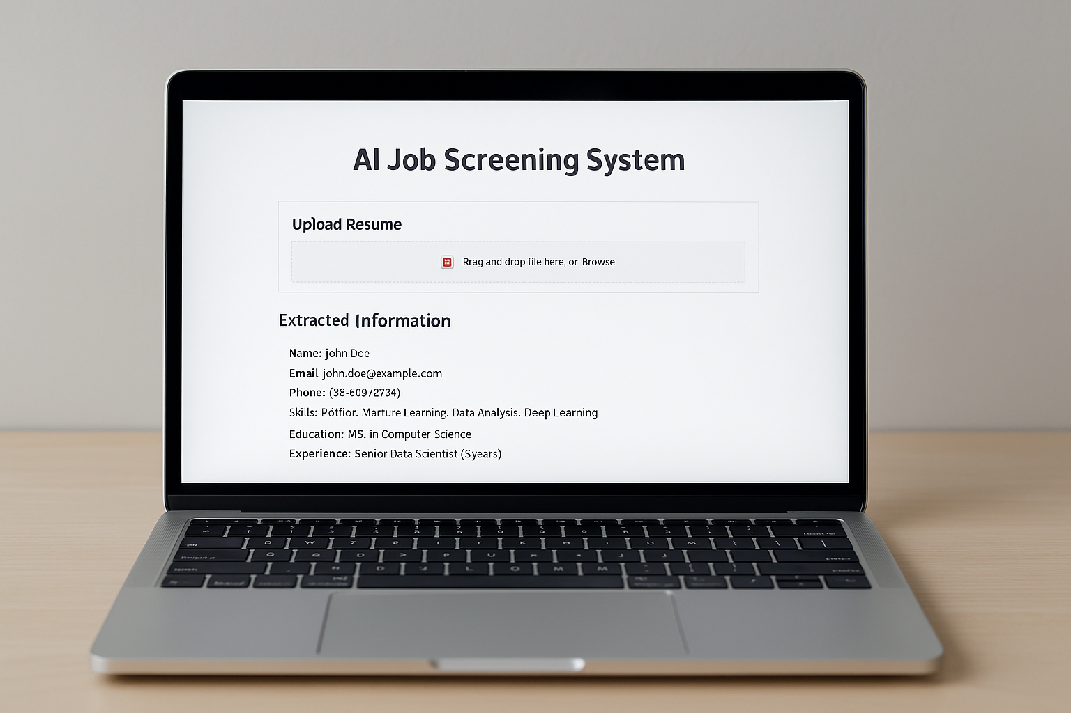
Entry Submission Summary
Idea Title (Provide a concise and impactful title for your idea.) | AI-Powered Job Screening System
Team Name | anisupriwk3j
Problem Statement | Hiring processes often involve manually screening thousands of resumes, making it time-consuming, biased, and inefficient. Recruiters struggle to identify the best candidates quickly, leading to delayed hiring, missed talent, and high costs.
Proposed Solution | Develop an AI-powered multi-agent system that automates job screening by: Parsing resumes efficiently using Natural Language Processing (NLP). Matching candidate skills with job requirements using AI models. Ranking candidates based on experience, education, and job fit. Providing recruiters with an intelligent dashboard to make faster hiring decisions.

Slide 4
Problem statement you are trying to address
Challenges in Job Screening & Recruitment
Problem Statement:
The traditional hiring process is slow, inefficient, and prone to bias due to manual resume screening. Recruiters face the following challenges:
1️⃣ Time-Consuming Process – Screening thousands of resumes manually delays hiring.
2️⃣ Unstructured Resume Formats – Resumes come in various formats (PDF, DOCX, images), making it difficult to extract relevant details.
3️⃣ Lack of Fairness & Bias – Human biases may influence hiring decisions.
4️⃣ Mismatch Between Candidates & Jobs – Finding the right talent quickly is a challenge.
5️⃣ High Recruitment Costs – Companies spend excessive time and resources on screening candidates.
Key Questions:
How can we automate and optimize resume screening?
Can AI reduce bias and improve hiring efficiency?
How do we match candidates accurately with job descriptions?
This problem impacts companies, recruiters, and job seekers, making AI-powered automation a crucial innovation

Slide 5
Proposed Solution Overview
AI-Powered Job Screening: Intelligent Resume Analysis
Solution Approach & Methodology:
Our AI-powered job screening system leverages Natural Language Processing (NLP), Machine Learning (ML), and Multi-Agent Systems to automate resume screening and candidate shortlisting.
🔹 Step 1: Resume Parsing
Extract key information (skills, experience, education) using NLP and OCR (for scanned resumes).
Standardize data from various formats (PDF, DOCX, images).
🔹 Step 2: Skill & Experience Matching
AI model compares candidate skills with job requirements using semantic similarity.
Ranks candidates based on relevance, experience, and education.

Slide 6
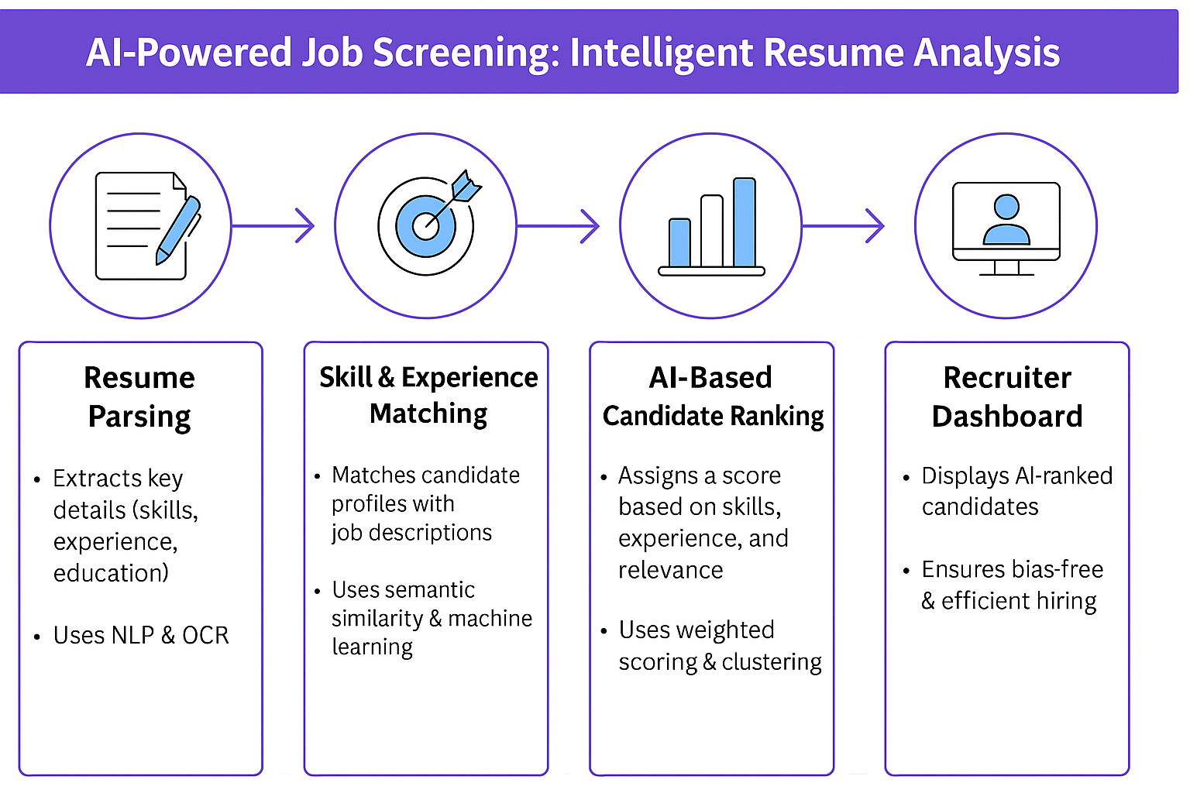
AI-Powered Job Screening: Intelligent Resume Analysis(Contd.)
🔹 Step 3: Intelligent Candidate Ranking
Generates a shortlist of top candidates using
weighted scoring.
Filters out irrelevant profiles automatically.
🔹 Step 4: AI-Powered Recruiter Dashboard
Interactive dashboard for recruiters to review
AI-ranked candidates.
Bias detection mechanisms to ensure fair hiring.
Outcome:-
✅ Faster & More Efficient Hiring – Reduces screening time from weeks to minutes.
✅ Fair & Data-Driven Selection – Eliminates human bias with AI-based ranking.
✅ Improved Job Match Accuracy – Ensures better talent acquisition.

Slide 7
💻 Technologies Used
🐍 Python – Used for all backend logic and data processing
📊 Pandas – For reading and handling resume data
🧠 spaCy – To extract keywords and skills from resumes (NLP)
📈 Scikit-learn – For basic machine learning like skill matching
🌐 Streamlit – To create a simple and interactive app interface
☁️ Google Colab – Used for testing and building the model
🐙 GitHub – To save and manage the project code

Slide 8
🧠 Agents' Interaction Design
💼 Job Description Summarizer Agent
🔹 Extracts key elements from job descriptions (skills, experience, responsibilities).
🔹 Uses 🗣️ NLP to summarize and structure the content.
📄 Resume Parsing & Matching Agent
🔹 Extracts information like education, skills, and work experience from resumes.
🔹 Uses 🤖 ML algorithms to match resumes with job descriptions and compute a match score.

Slide 9
🤖 Agents' Interaction Design(Contd.)
✅ Shortlisting Agent
🔹 Selects top candidates based on a predefined match threshold (e.g., 80%+ match).
🔹 Ensures only the most relevant profiles proceed further.
📅 Interview Scheduling Agent
🔹 Sends interview invitations to shortlisted candidates automatically.
🔹 Aligns interview slots with recruiter and candidate availability.
🔹 Sends 📧 email confirmations and updates.
📊 Feedback & Learning Agent (optional)
🔹 Collects feedback post-interview to improve matching algorithms.
🔹 Continuously trains the model based on recruiter preferences and hiring patterns.

Slide 10
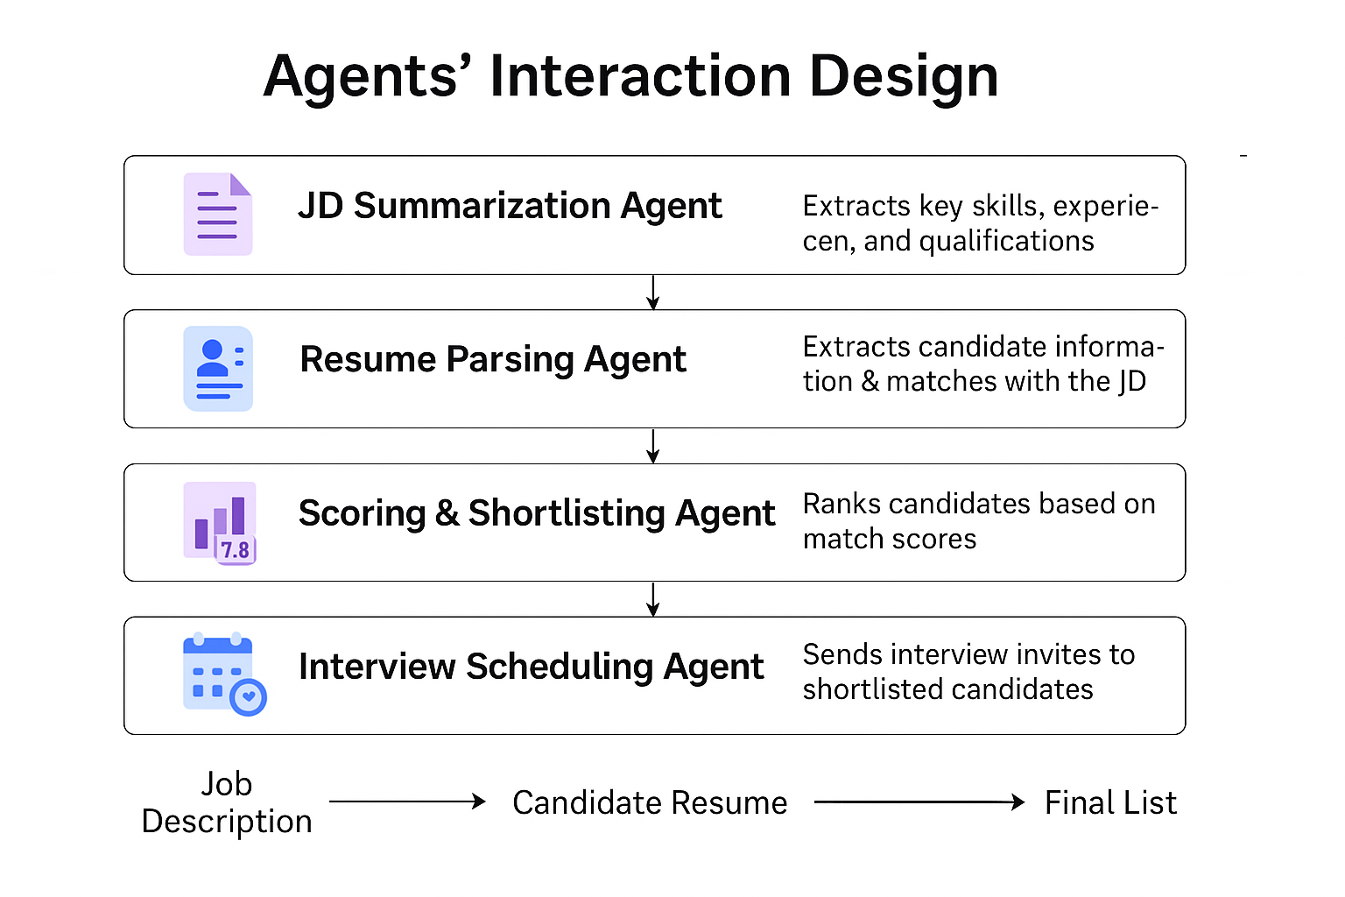

Slide 11
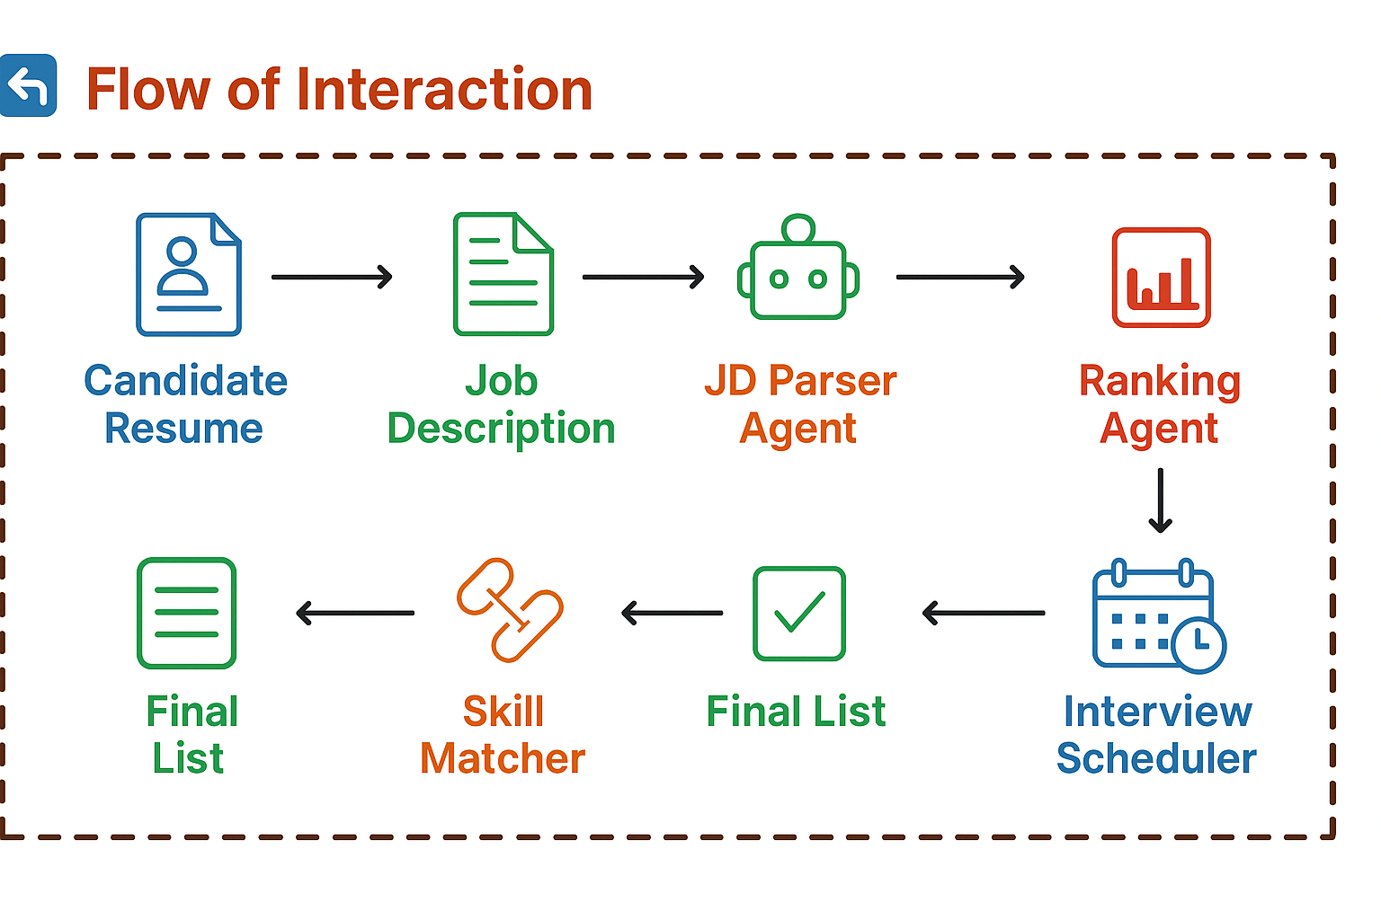

Slide 12
Code structure
Creating an AI-Powered Job Screening System involves structuring your code in a way that separates concerns, making it easier to maintain and extend.
OFG_Job_Screening_System/
│
├── data/
│ ├── resumes/ # Directory to store resumes
│ └── job_descriptions/ # Directory to store job descriptions
│
├── notebooks/ # Jupyter notebooks for experimentation
│ └── model_building.ipynb # Notebook for building and testing the model
│
├── src/ # Source code for the application
│ ├── __init__.py
│ ├── app.py # Main Streamlit app
│ ├── data_processing.py # Functions for reading and processing data
│ ├── nlp.py # Functions for NLP tasks (keyword extraction)
│ ├── model.py # Functions for model training and prediction
│ └── utils.py # Utility functions (e.g., logging, configuration)
│
├── requirements.txt # Python dependencies
├── README.md # Project documentation
└── .gitignore # Files to ignore in Git

Slide 13
Code Breakdown
1. data/:- This directory contains subdirectories for storing resumes and job descriptions. You can organize your data files here.
2.notebooks/:- This folder is for Jupyter notebooks where you can experiment with data processing, model building, and testing. The model_building.ipynb can be used to prototype your machine learning model.
3. src/:- This is where the main source code resides.
app.py: The entry point for your Streamlit application. This file will handle user interactions and display results.
data_processing.py: This module will contain functions to read resumes and job descriptions using Pandas, and preprocess the data (e.g., cleaning, normalization).
nlp.py: This module will use spaCy to extract keywords and skills from resumes. It will contain functions for NLP tasks such as tokenization, named entity recognition, and keyword extraction.
model.py: This module will handle the machine learning aspects using Scikit-learn. It will include functions for training the model, making predictions, and evaluating performance.
utils.py: This module can contain utility functions that are used across different parts of the application, such as logging, configuration management, or helper functions.

Slide 14
Code Breakdown(Contd.)
4.requirements.txt:- This file lists all the Python dependencies required for your project. You can generate this file using pip freeze > requirements.txt.
5.README.md:- This file should provide an overview of the project, installation instructions, usage, and any other relevant information.
6.gitignore:- This file specifies files and directories that should be ignored by Git, such as virtual environments, data files, and other temporary files.

Slide 15
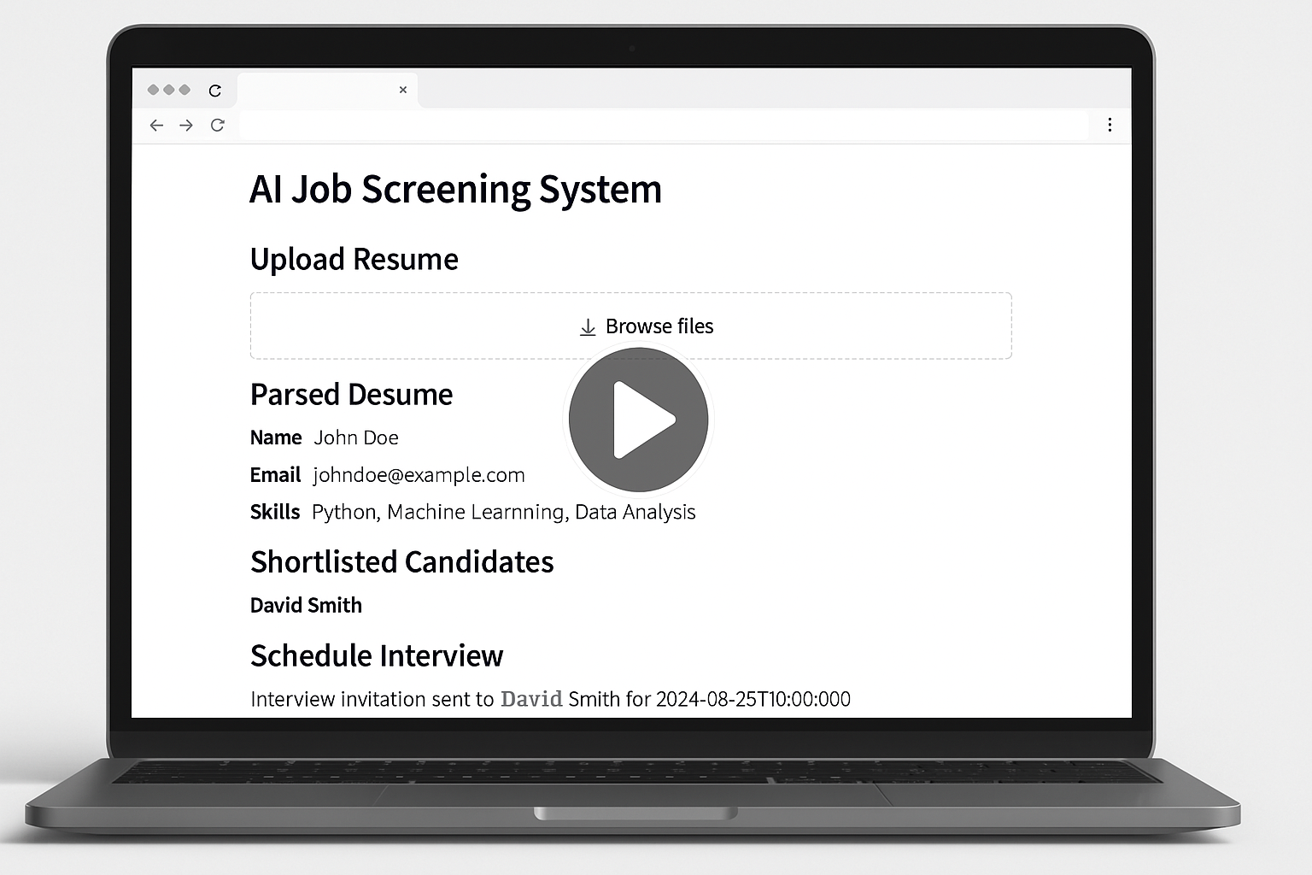
Demo video

Slide 16
Conclusion
🔹 Our AI-powered job screening system automates the end-to-end recruitment process, significantly reducing manual effort.
🔹 It ensures faster, fairer, and more accurate candidate selection by:-
Parsing resumes using NLP
Matching skills with job descriptions
Ranking candidates based on fit
Automating interview scheduling
🔹 Recruiters save time and effort, while candidates experience a smoother hiring journey.
🔹 This system directly addresses the original problem of inefficient and biased manual screening, making hiring data-driven and scalable.
🔹 The solution can be easily integrated with existing HR systems and scaled across domains.

Slide 17
References/Other details
Technologies & Tools Used
Python, Pandas, SpaCy, Scikit-learn, Streamlit
Google Colab (for development)
GitHub (version control & collaboration)
Image & Video Generation Tools
HTML AND CSS FOR WEBSITE DESIGN

Slide 18
Resume Parsing Support
SpaCy NLP & custom keyword extraction techniques
Data cleaning using Pandas
Team Members
SUPRIYA MANDAL(anisupriwk3j
[Team Members, if any]
Special Thanks
Faculty mentors and project coordinators
Open-source communities and documentation

Slide 19

Thank You

